Slide 1
FINANCIAL AID 101

Slide 2
Topics We Will Discuss
What is financial aid?
Calculating financial need
Categories, types, and sources of financial aid
Free Application for Federal Student Aid (FAFSA®)
Special circumstances
FAFSA completion events: College Goal Wisconsin
Scholarship Tips
Staying in touch with UW-Stevens Point

Slide 3
What is Financial Aid?
Financial aid consists of funds provided to students and families to help pay for postsecondary educational expenses.
Scholarships
Grants
Work Study
Loans

Slide 4
Calculating Financial Need
Cost of attendance (COA)
– Expected family contribution (EFC)
= Financial need

Slide 5
Calculating Cost of Attendance (COA)
Tuition and fees
Direct Expenses
Housing and food
Specific to each school
Books and supplies
Indirect Expenses
Transportation
Miscellaneous and personal

Slide 6
Calculating Expected Family Contribution (EFC)
Student contribution
Financial strength index.
Ability to pay postsecondary educational expenses.
(Not necessarily what the student/family will be charged)
Information from FAFSA
Parent contribution
(for dependent students)
Specific to each student

Slide 7
Calculating Financial Need
Cost of attendance (COA)
– Expected family contribution (EFC)
= Financial need

Slide 8
Categories of Financial Aid
Need-based aid
Non-need-based aid

Slide 9
Types of Financial Aid
Loans
Scholarships
Self-Help Aid
Gift Aid
Work-Study Employment
Grants

Slide 10
Sources of Financial Aid
Federal Government
Employers
States
Private Sources
College and Universities

Slide 11
Free Application for Federal Student Aid
Collects demographic and financial information as well as information about your college and housing plans
This information used to calculate the expected family contribution (EFC)
Most colleges use EFC to offer financial aid
Available in English and Spanish

Slide 12
Free Application for Federal Student Aid
May be filed at any time during an academic year, but no earlier than October 1st prior to the academic year for which the student requests aid
The 2023-2024 FAFSA opened October 1, 2022
Yes, a FAFSA must be completed each year for financial aid
Colleges may set FAFSA priority dates
In general, filling out the FAFSA earlier is better than later

Slide 13
FAFSA on the Web (FOTW)
Best Way to Complete the FAFSA?
Built-in edits to prevent costly errors
Skip-logic allows student and/or parent to skip unnecessary questions
Option to use Internal Revenue Service (IRS) Data Retrieval Tool to import tax data
More timely submission of original application and any necessary corrections
More detailed instructions and “help” for common questions
Ability to check application status online
Simplified application process in the future

Slide 14
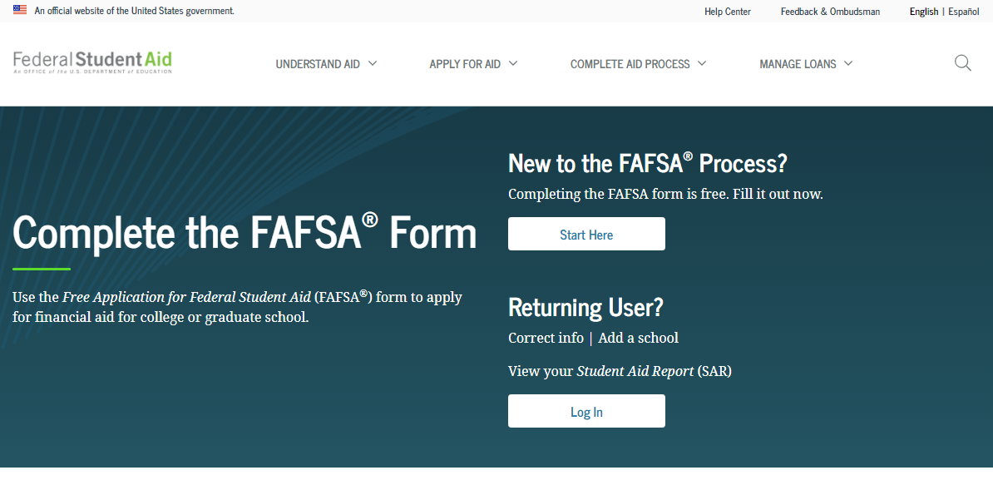
Free Application for Federal Student Aid
FOTW
studentaid.gov

Slide 15
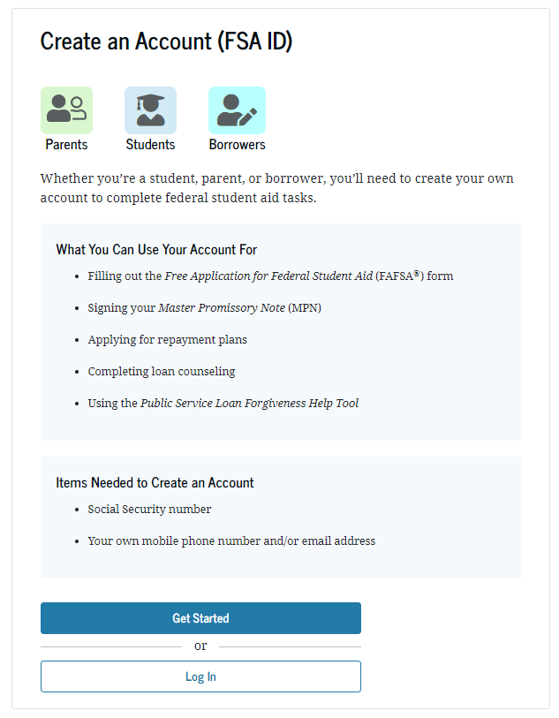
Free Application for Federal Student Aid
FSA ID
Used for FAFSA completion and allows access to certain U.S. Department of Education websites
Student and parent must create own FSA ID
May be used throughout financial aid process, including subsequent school years
Only the owner should create an FSA ID
Apply at https://studentaid.gov/fsa-id/create-account/launch

Slide 16
Frequent FAFSA Errors
Social Security Numbers
Divorced/widowed/remarried parental information
Income earned by parent/stepparent
Untaxed income
U.S. income taxes paid
Asset and investment net worth
Household size
Number of household members in college

Slide 17
What happens after you submit the FAFSA?
CPS
College
Student
Institutional Student Information Record
Student Aid
Report

Slide 18
How to Make a FAFSA Correction
Using FAFSA on the Web, if student has a FSA ID
Updating a paper Student Aid Report
Submitting documentation to college’s financial aid office

Slide 19
Special Circumstances
Conditions might exist that cannot be documented with the FAFSA
Complete FAFSA the way the form requests
Check with your college’s financial aid office to see if they have a financial aid appeal process
Submit written explanation and documentation
College will review and request additional information if necessary
Decisions are final and cannot be appealed to U.S. Department of Education

Slide 20
Special Circumstances Examples
Unusual uncovered medical/dental expenses
Death of parent or spouse
Loss of employment or income
Extraordinary dependent care
Divorce
Secondary school tuition
Student cannot obtain parental information
When in doubt, complete the FAFSA exactly how it asks for the information, then contact your college’s Financial Aid Office for next steps.

Slide 21
MARK YOUR CALENDARS!
Free FAFSA completion events
44 in-person events and 4 virtual sessions
All events start promptly at 6 p.m.
ATTEND AN EVENT TO BE ENTERED TO WIN A SCHOLARSHIP!
For location information and to register visit: https://collegegoalwi.org

Slide 22
LIVE SP VIRTUAL VISITS
FREE EVENT SERIES
https://apply.uwsp.edu/portal/virtual-visits-point
The best way to learn how to Discover Your Purpose from the comfort of your home is a Live SP Virtual Visit.
This virtual presentation series (via Zoom) will introduce you to UW-Stevens Point and answer your questions.
Connect with us about our beautiful campus where you will learn how our faculty and staff can help you grow intellectually, culturally, and professionally.

Slide 23
LIVE SP VIRTUAL VISITS
Scholarships 101
FREE EVENT
11/1/2022 | 6:30pm
Never too early to start!
Assemble a list of references
Make a list of your accomplishments in and out of the classroom, plus other experiences
Create a calendar of deadlines and devote time to applying
Keep a running list of questions and answers
Double check all information before submitting
Complete the FAFSA even if you think you won’t qualify for aid
Small scholarships add up!
APPLY! APPLY! APPLY!

Slide 24
MARK YOUR
CALENDARS!
UWSP SCHOLARSHIPS PRIORITY DATE
NOVEMBER 15!

Slide 25
DISCOVER YOUR PURPOSE AT uw-Stevens Point
Get connected with UWSP to learn about our:
Academic Programs
Campus Life
Special Events
Scholarships

Slide 26
RESOURCES
DISCOVER YOUR PURPOSE AT uw-Stevens Point
Financial Aid and Veteran Services staff are available by appointment (715-346-4771 or finaid@uwsp.edu)
Review our FAQs and learn more about financial aid https://www.uwsp.edu/finaid/Pages/FAQ.aspx
Register for GradReady, our free online financial literacy tool: https://gradready.com/gradready/sponsor/uwsp

